Slide 1



INFORMATION SESSION
with
KAPLAN / PARTNERED AGENCIES
November 9, 2021

Slide 2






About CIBT Education Group

Slide 3
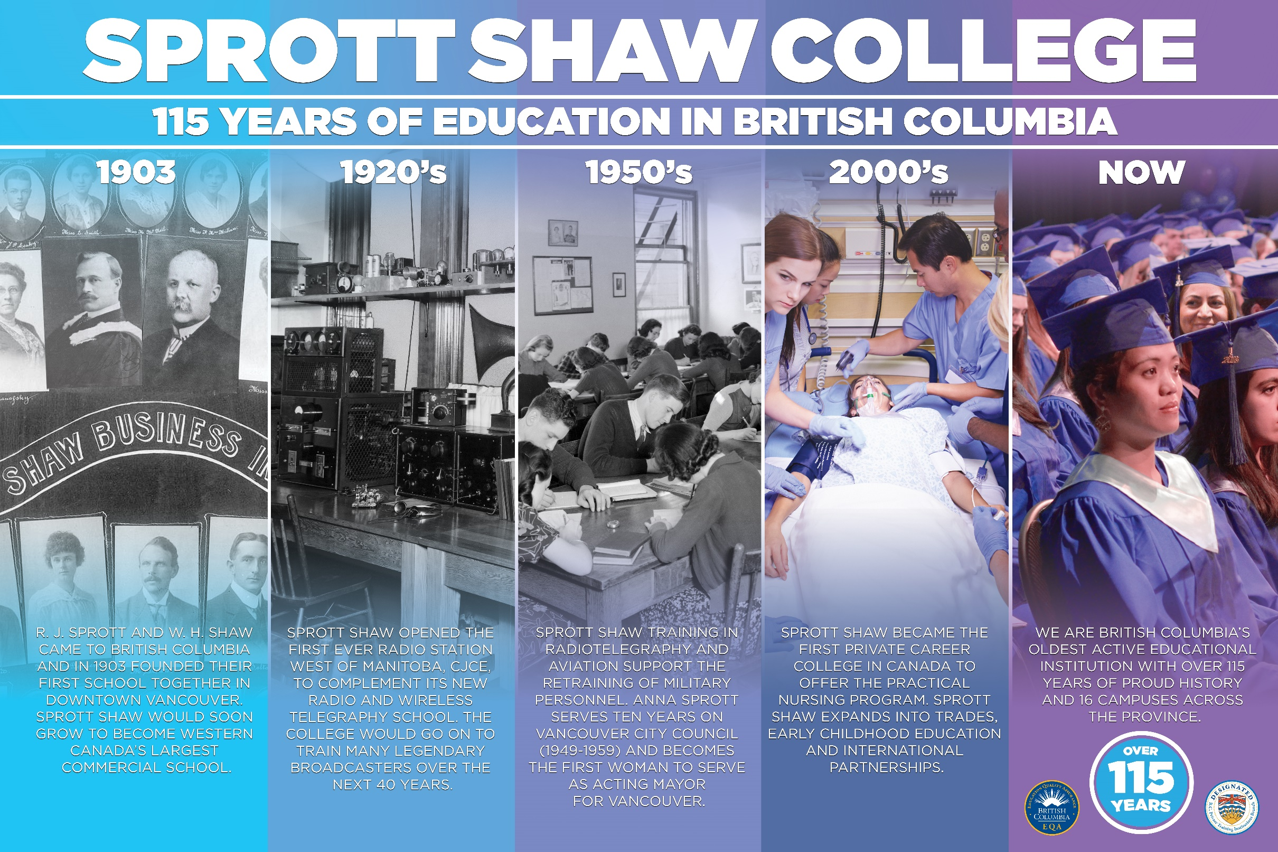
1903
BIGGEST
500,000
16
4,500
130
Sprott Shaw Business Institute was founded in 1903
One of the OLDEST and BIGGEST Private Institutions in BC
Number of total graduates: Approximately 500,000
16 campuses across BC
4,500 students – 80% are local Canadian or PR students
Over 130 Diploma & Certificate programs
“Over 100 Years of History”

Slide 4






Accreditation
PTIB (Private Training Institutions Branch)
EQA (Education Quality Assurance)
IRCC (Immigration, Refugees and Citizenship Canada )
NACC (National Association of Career Colleges)
BBB (Better Business Bureau)
AHLA (American Hotel & Lodging Association)
BCCNP (British Columbia College of Nursing Professional)
FITT (Forum for International Trade Training)
MCFD (Ministry of Children and Family Development)

Slide 5



SSC Campus Locations
16 Campuses
across British Columbia
Vancouver – Pender
Vancouver – Seymour
East Vancouver
Richmond
Burnaby
New Westminster
Surrey
Victoria
Abbotsford
Chilliwack
Kamloops
Kelowna
Nanaimo
Maple Ridge
Penticton
Osoyoos

Slide 6
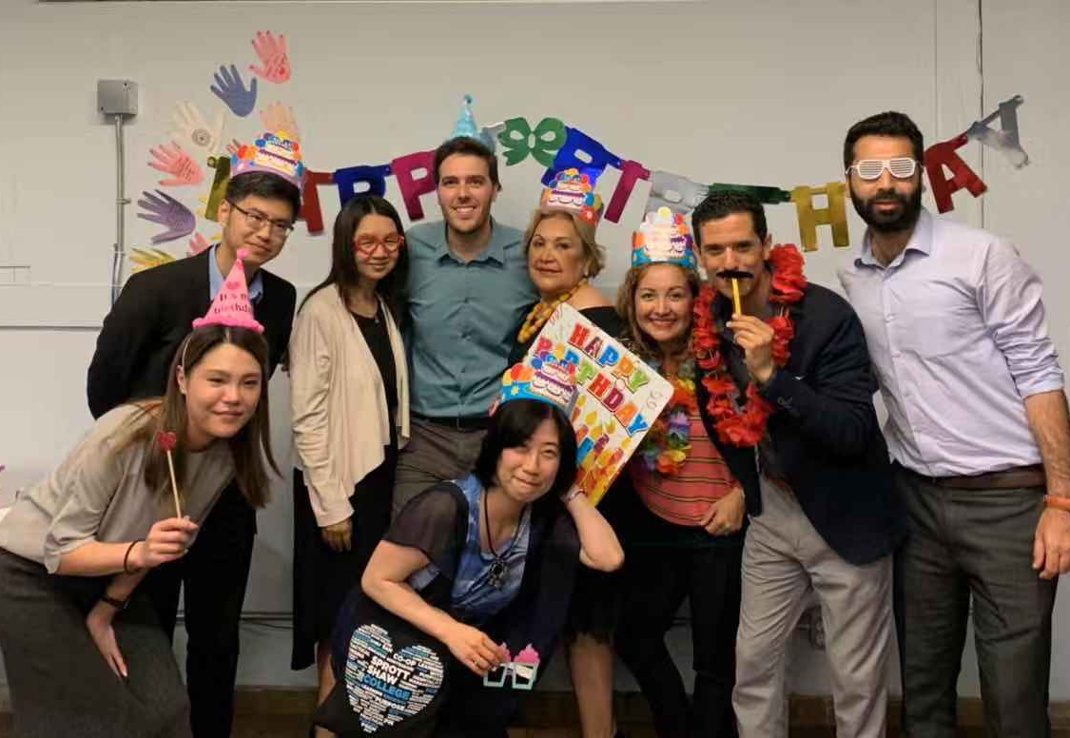

Why SSC
117 years of history
One of the largest private institutions in British Columbia
Largest Practical Nursing training institution
Monthly starts
16 campus locations across BC
Flexible class schedule
Various Practicum & Co-op options
Dual Credentials with University Pathway Programs (Diploma + Degree)

Slide 7






SSC Faculties
BUSINESS / ADMINISTRATION
TOURISM /HOSPITALITY
EARLY CHILDHOOD EDUCATION
/ COMMUNITY SUPPORT
NURSING / HEALTH CARE
TRADES
UNIVERSITY PATHWAY / CO-OP

Slide 8
SSC Programs
CO-OP PROGRAMS
Business Administration Management with Co-op 94
Business Administration Principles with Co-op 46
Business Administration Sales & Digital Marketing with Co-op 58
Business Fundamentals with Co-op 32
Global Business Management with Co-op (Post Graduate Diploma) 77
Global Marketing Management with Co-op 103
Tourism / Hospitality Management Co-op 62
Tourism / Hospitality Management & Business Administration Principles Accelerated with Co-op 100
Health Care Assistant Internationally Educated Co-op 66
Post Graduate Certificate in Nursing with Co-op (Post Graduate Certificate) 81

Slide 9
SSC Programs
BUSINESS
Business Administration Bookkeeping 33
Business Administration Management 49
Business Administration Principles 33
Business Administration – Payroll 33
Business Administration Sales & Digital Marketing 33
Business Fundamentals 17
Global Business Management (Post Graduate Diploma) 45
International Trade 25
International Trade and Business Management 55
Legal Administrator 33
Veterinary Assistant 33
TOURISM AND HOSPITALITY
Tourism / Hospitality Management 37
Tourism / Hospitality Management with Practicum 41
Tourism / Hospitality Management & Business Administration Principles Accelerated 53

Slide 10
SSC Programs
CHILDCARE
Early Childhood Education Basic (Certificate) 45
Early Childhood Education - Infant & Toddler (Basic + IT) 65
Early Childhood Education - Children with Exceptionalities (Basic + CWE) 65
Early Childhood Education Diploma (Basic + IT + CWE) 77
Early Childhood Education-Post Basic (IT + CWE) 32
Early Childhood Education Infant & Toddler (Certificate) 20
Early Childhood Education Children with Exceptionalities CWE (Certificate) 20
Early Childhood Education Assistant 14
Montessori Early Childhood Teacher Education (Certificate) 38
Early Childhood Education – Montessori (ECE Basic + Montessori) 80
Education Assistant 43

Slide 11


SSC Programs
HEALTHCARE
Community Support Worker - Social Services 49
Dental Assistant 45
Health Care Assistant 29
Health Care Assistant-Internationally Educated 34
Medical Office Administrator 33
Medical Office Administrator with Practicum 37
Medical Office Administrator Health Unit Clerk 49
Medical Office Administrator Health Unit Clerk with Practicum 53
Post Graduate Certificate in Nursing 45
Pharmacy Assistant 33
Pharmacy Assistant with Practicum 37
Practical Nursing 75
TRADES
Computer Aided Design Technology 12
Electrical Foundations 25

Slide 12

SSC Programs
UNIVERSITY TRANSFER
BCIT
City University – Canada
Fairleigh Dickinson University – Canada
Acsenda School of Management

Slide 13

FACULTY
OF
CHILDCARE

Slide 14
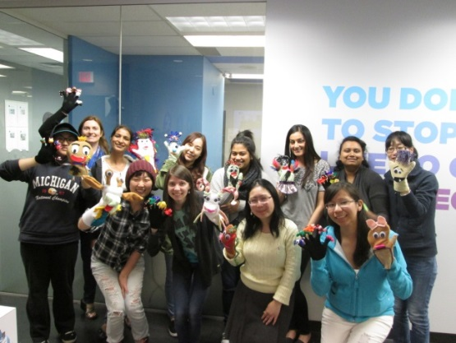
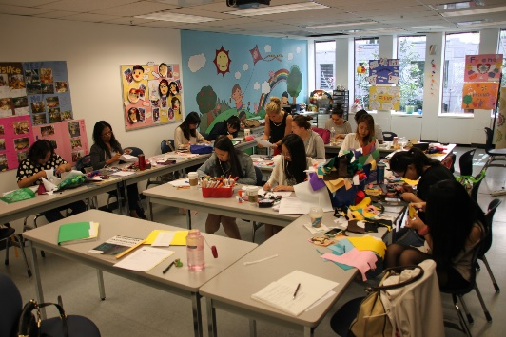
Childcare Programs
ECE Basic Certificate: 45 weeks
ECE-IT Diploma: 65 weeks
ECE-CWE Diploma: 65 weeks
ECE Diploma: 77 weeks
ECE Post Basic Diploma: 32 weeks
ECE-IT Certificate: 20 weeks
ECE-CWE Certificate: 20 weeks
ECE Assistant: 14 weeks
ECE Montessori Certificate: 38 weeks
ECE Montessori Diploma: 80 weeks

Slide 15
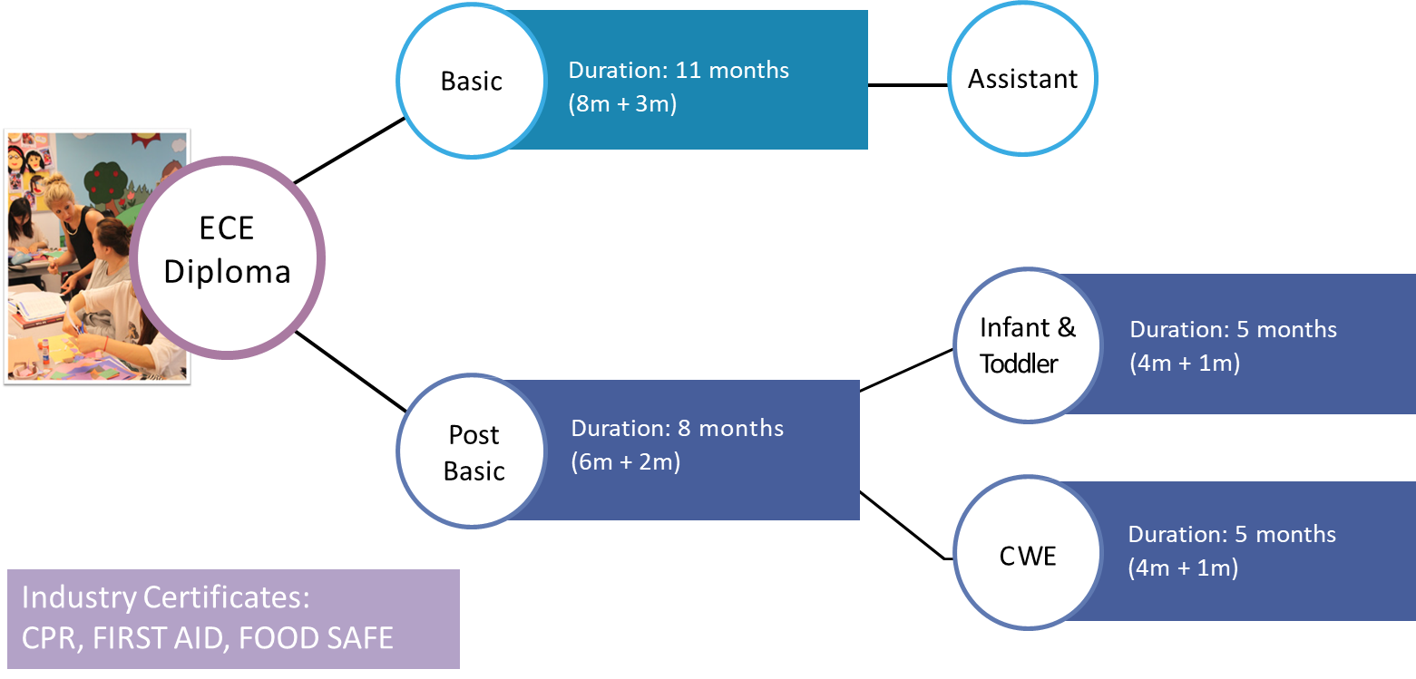
Childcare Programs

Slide 16
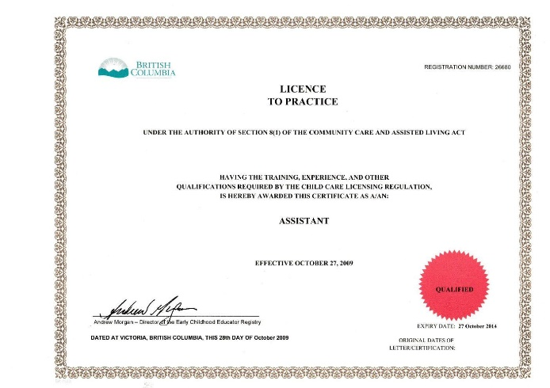
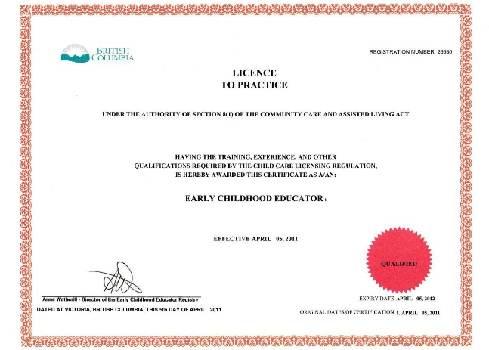
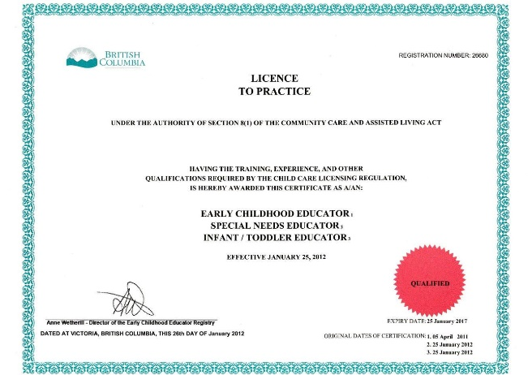
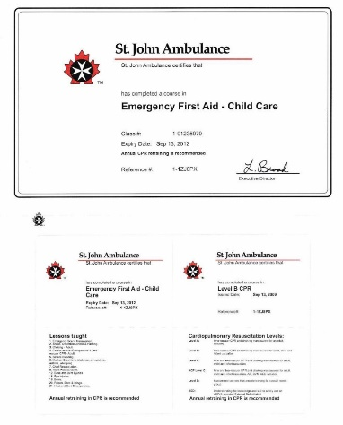

Childcare Licenses
Assistant
Basic
Basic + I&T + Special Needs

Slide 17
FACULTY
OF
HEALTHCARE

Slide 18
Canadian Health Care System Structure
Employed:
General medical
Surgical hospital
Government agencies
Nursing care facilities
Nurse specialist
Duties:
Handling medications
Handling medical tests
Reports of a patient
Carry out various tasks without any direction
Registered
Nurse
Employed:
Physician’s office
Nursing care facilities
Psychiatric hospitals
Outpatient clinics
Duties:
Patients' crucial signs
Monitor heartbeat, blood pressure
Work under supervision of
registered nurse and doctor
Licensed Practical Nurse
Employed:
Home care
Acute care
Duties:
bathing, oral hygiene
Grooming, dressing
Taking temperature
Pulse and respiration
Health Care Assistant

Slide 19
SSC Healthcare Programs
Program | HCAIE-Coop | HCA | PN | PGCN-Coop
Duration | 66 Weeks (1 year 4 months) | 29 Weeks (7 months) | 75 Weeks (1 year 6 months) | 81 Weeks (1 year 7 months)
Work Components | Practicum – 8 weeks Coop – 30 weeks | Practicum – 8 weeks | Clinical – 20 weeks | Coop – 36 weeks
English Requirement | IELTS 5.5 | IELTS 6.0 | IELTS 7.0 | IELTS 6.0
Campuses | Vancouver | Many | Many | Vancouver
Start Date | Jan / May / Sep | Monthly | 2 -3 times a year per campus | Mar / Oct
Education Requirement | High School | High School | High School | BSc. In Nursing

Slide 20

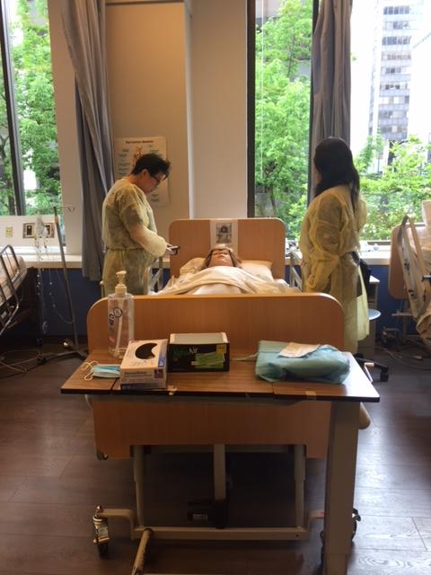
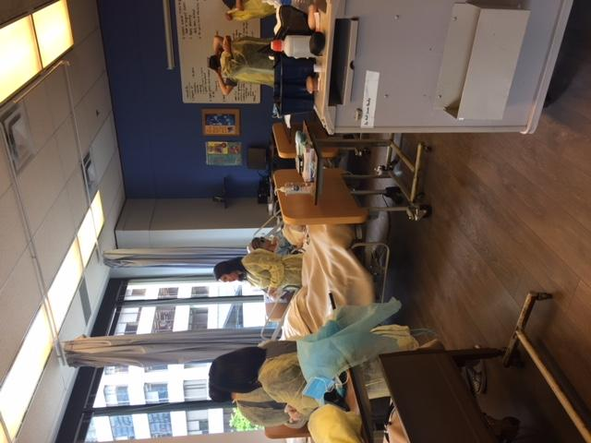
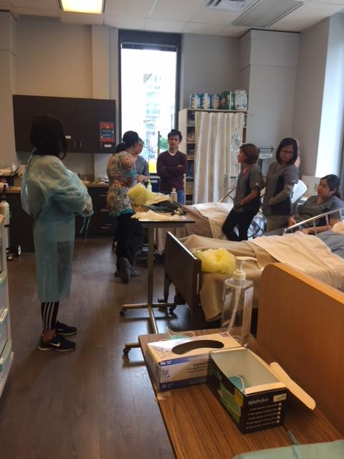

Student Lab Time

Slide 21
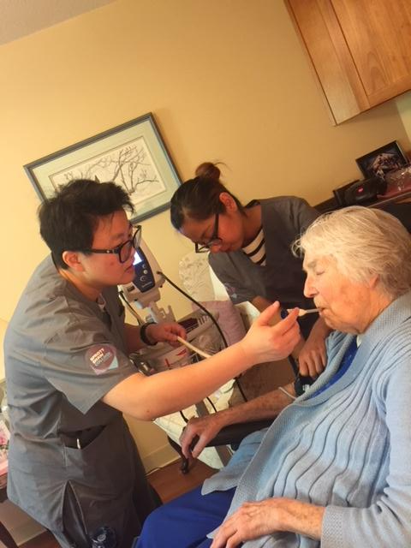
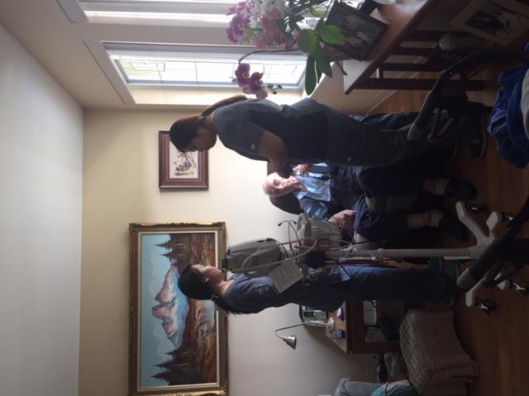
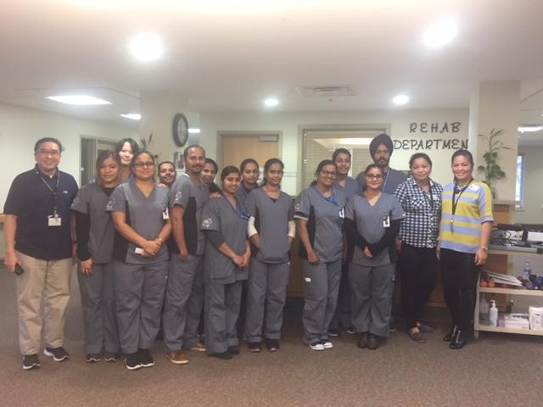
Student Practice

Slide 22
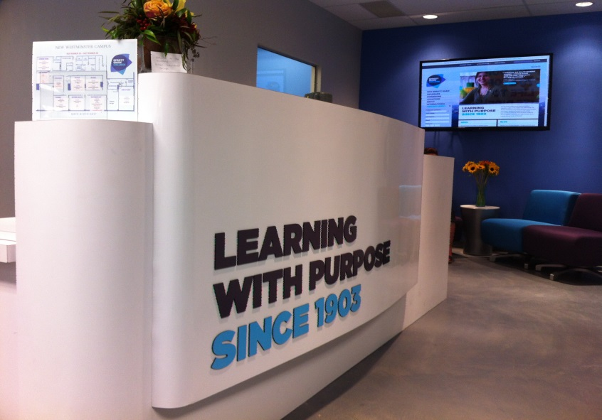
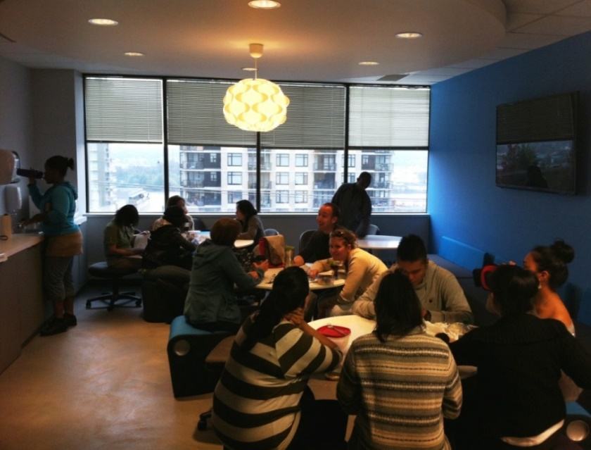
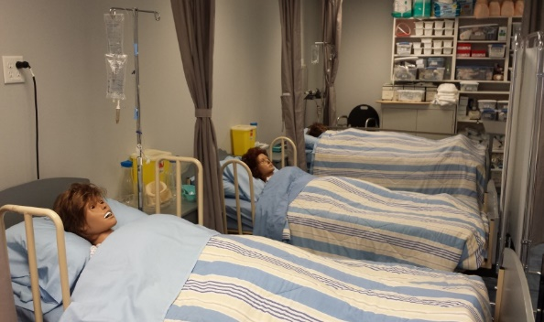
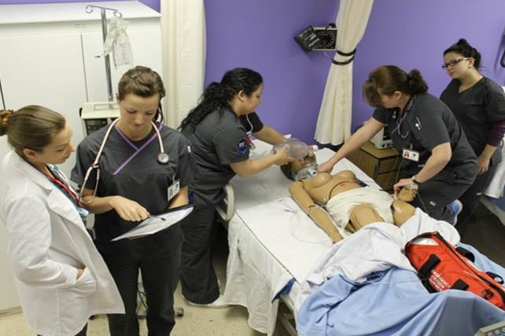
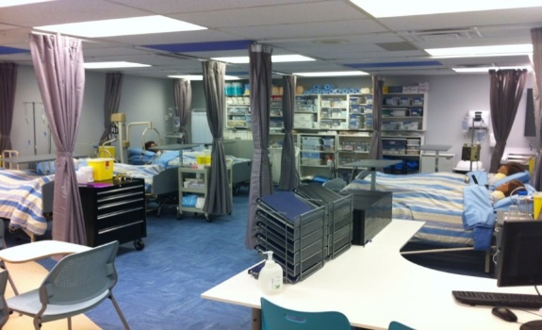
Campus Photos

Slide 23
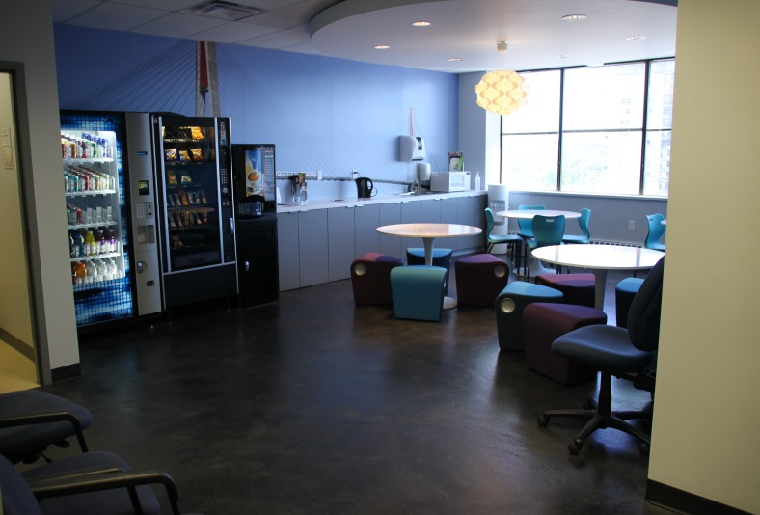
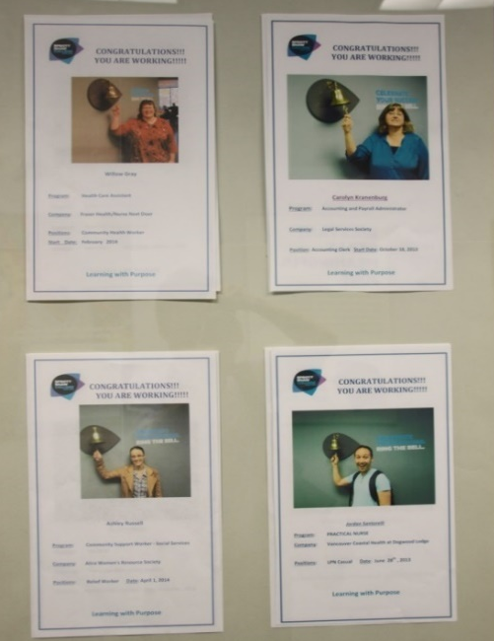
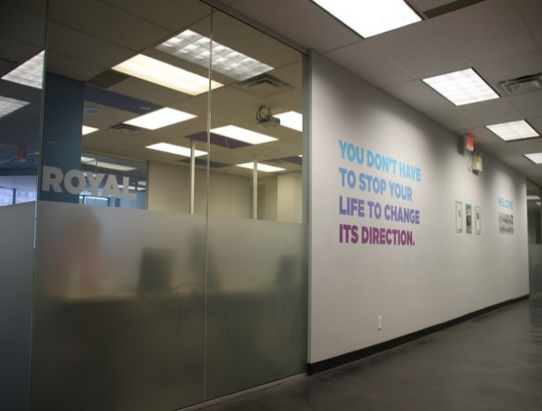
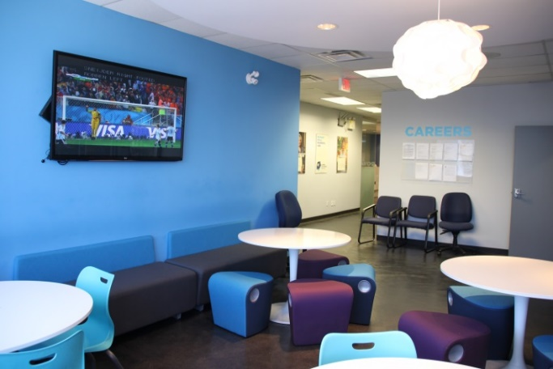
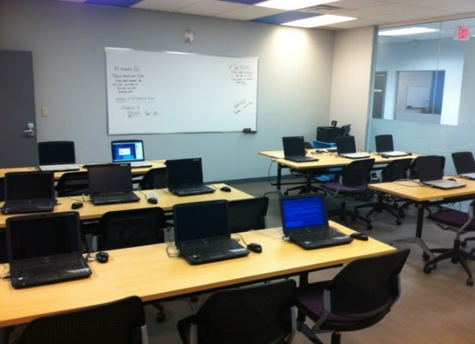

Campus Photos

Slide 24



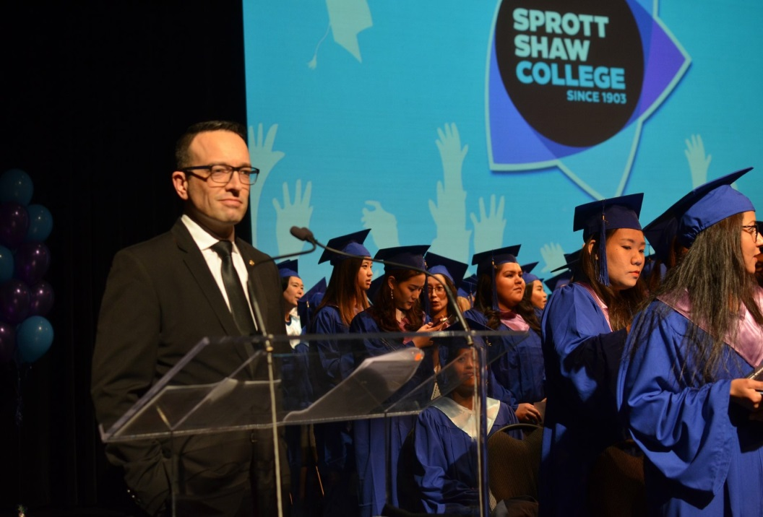

Graduation Ceremony

Slide 25
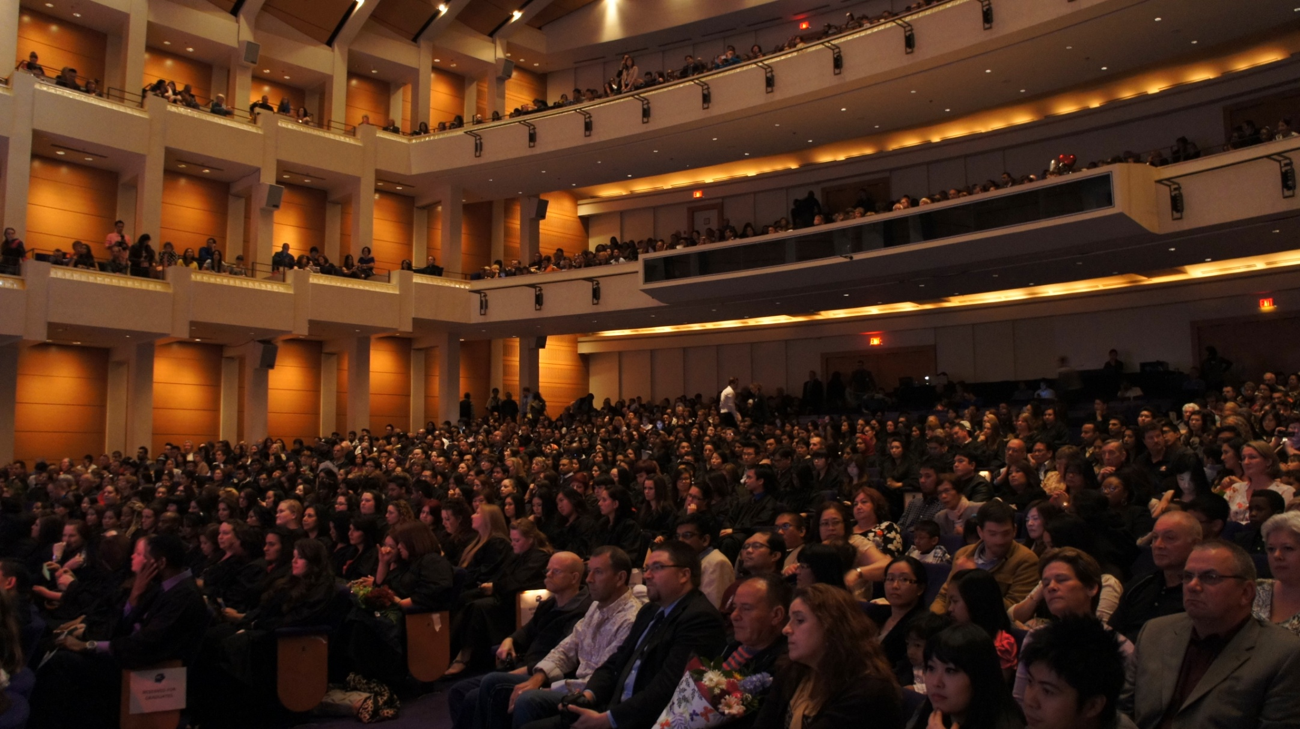
Graduation Ceremony

Slide 26
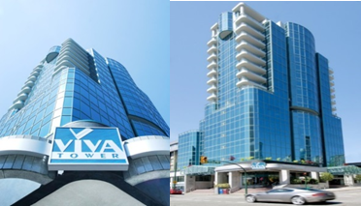
STUDENT RESIDENCES
- GLOBAL EDUCATION CITY -

Slide 27

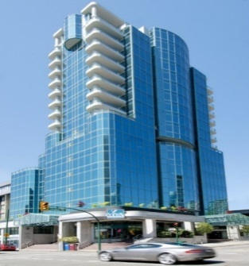
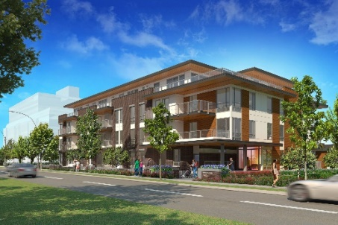
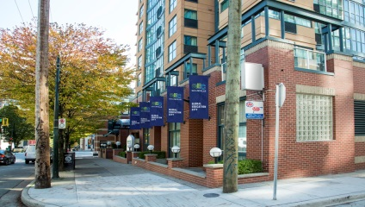
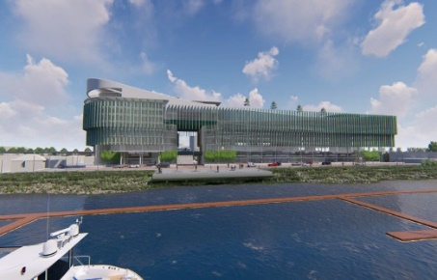
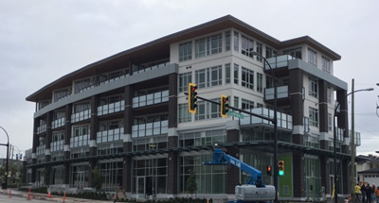

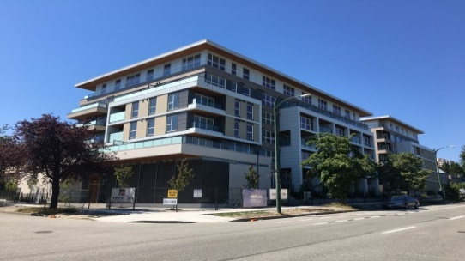
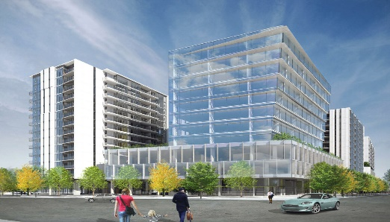
Student Residences
GEC® Viva
Downtown Vancouver
224 beds
GEC® King Edward
Cambie and W King Edward Ave, Vancouver
GEC® Granville
Downtown Vancouver
221 beds
GEC® CyberCity
Richmond
GEC® Burnaby Heights
North Burnaby
Serviced apartment: 30 residential units + 4 commercial units
GEC® Education Mega Center
Downtown Surrey
GEC® Pearson
Cambie and 60th Ave, Vancouver
310 beds
GEC® Education City Richmond
Located in Richmond City Center

Slide 28


Student Residences
VIVA TOWER - 230 Beds
1311 Howe Street, Vancouver, BC
GEC GRANVILLE - 200 Beds
718 Drake Street, Vancouver
Serviced Apartments Hotels for International Students
Serviced Apartments & Hotels to be located throughout Lower Mainland designed
for students studying in
Metro Vancouver

Slide 29
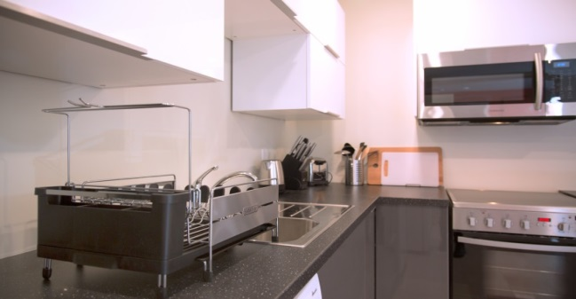

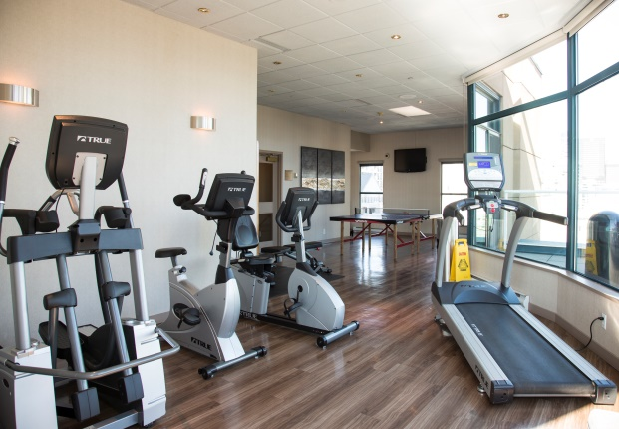
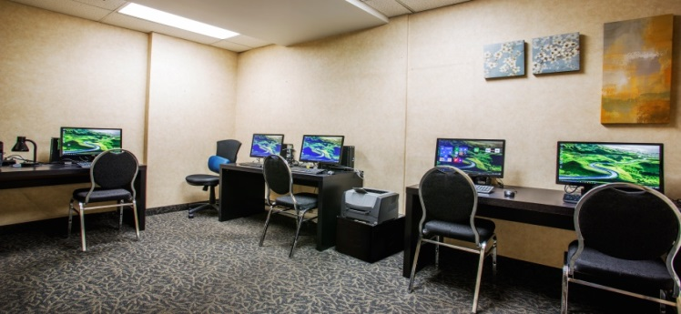
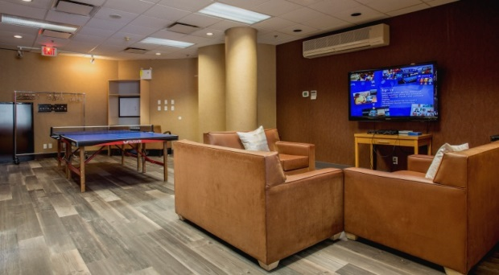

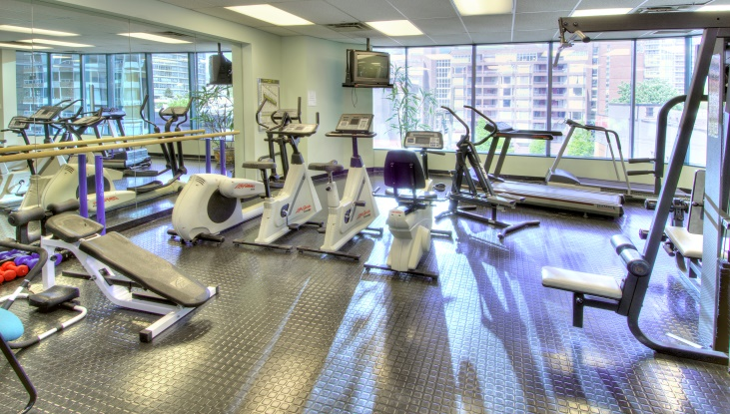
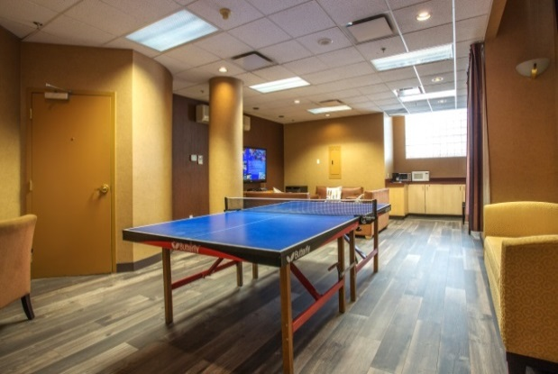
Student Residences
Services & Amenities

Slide 30

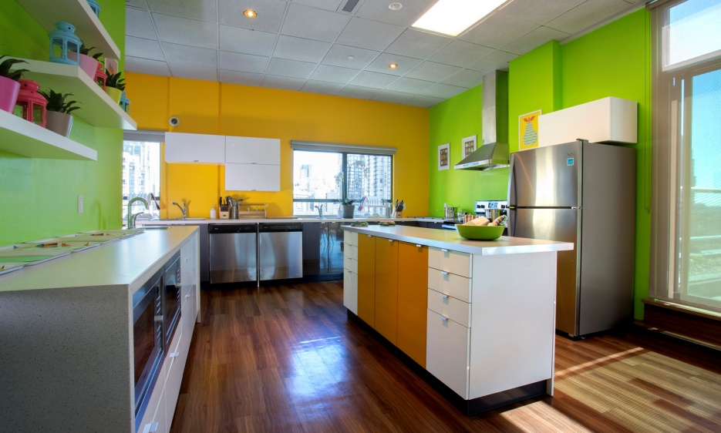
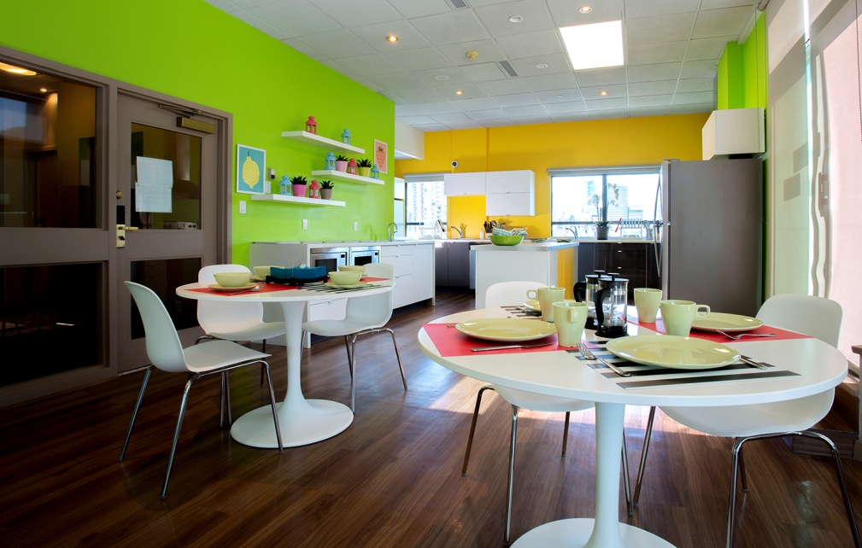

Student Residences
Fully Equipped Shared Kitchen
Dining Room

Slide 31
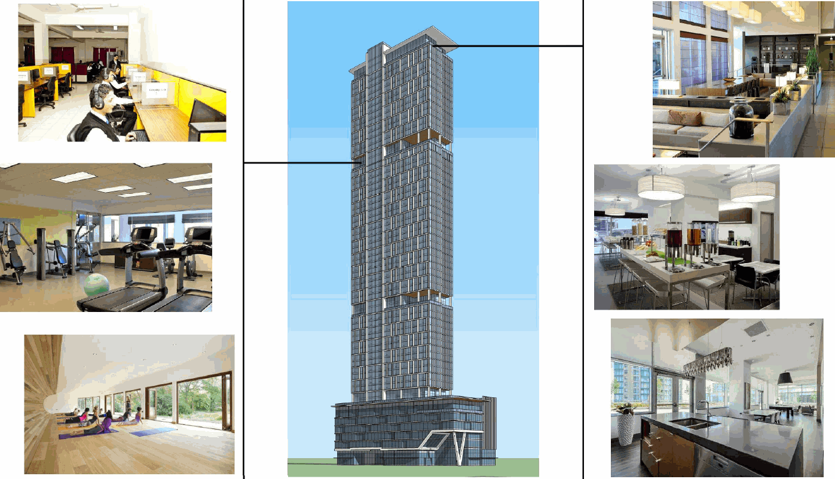
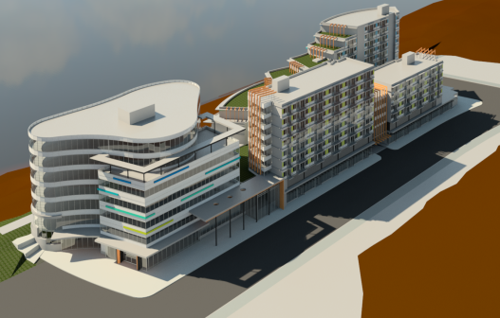
Student Residences
GEC® Education Mega Center
GEC® Education Super Center

Slide 32

THANK YOU
Sprott Shaw College – International Office
#1500 - 543 Granville Street, Vancouver, British Columbia Canada V6C 1X8

